Slide 1
Research Update

Slide 2
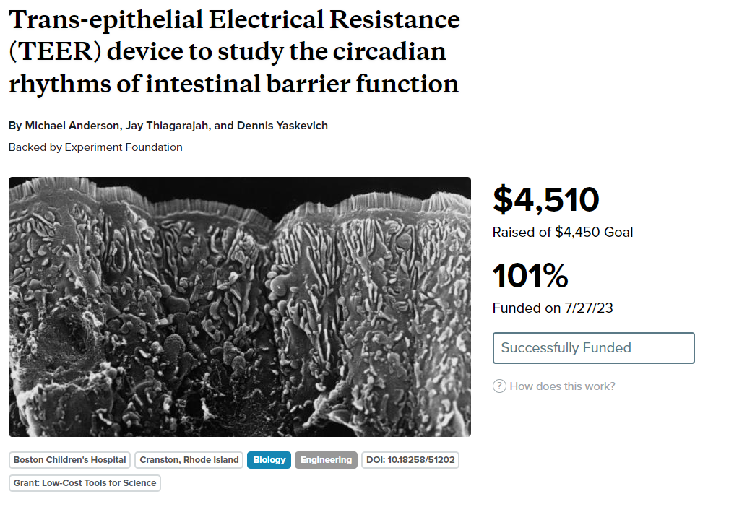
Flexi-TEER
Won grant from experiment.com for Flexi-TEER project.

Slide 3
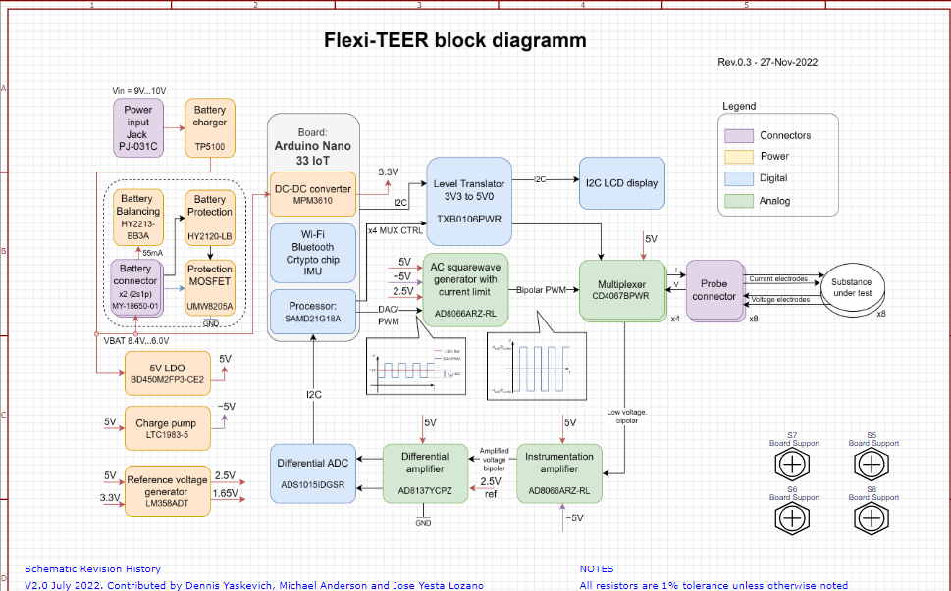
Block Diagram

Slide 4
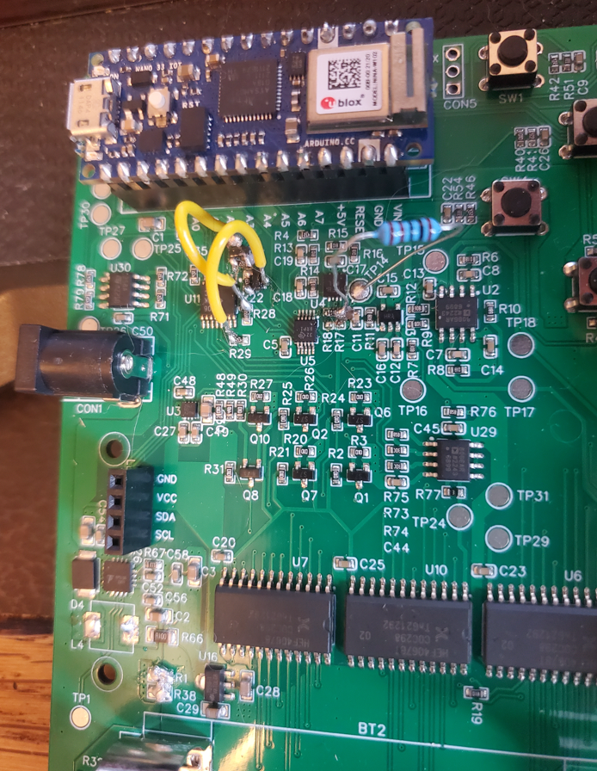
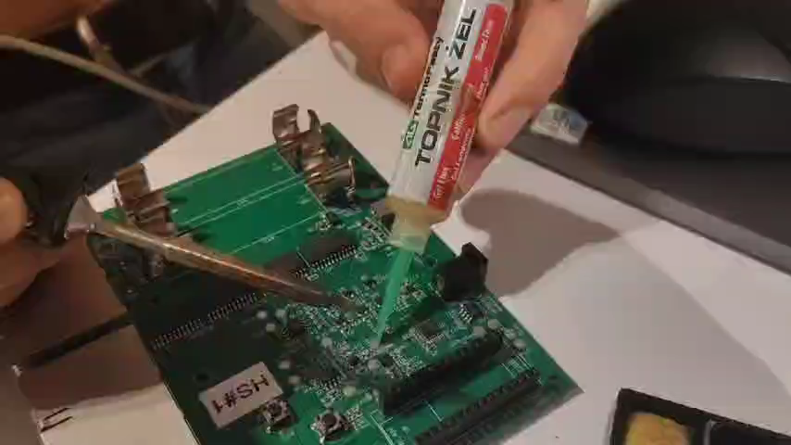

Slide 5
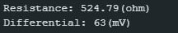
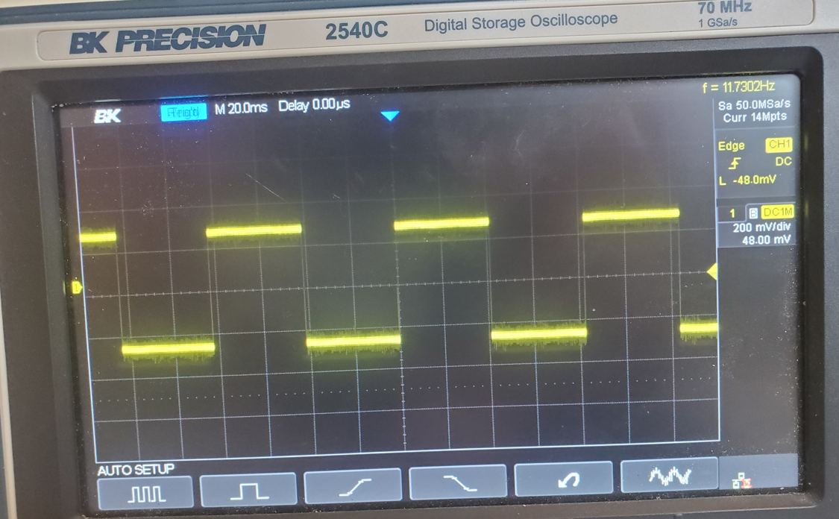
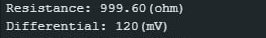
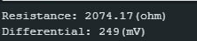
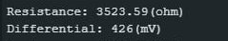
Symmetric AC Square Wave
Actual: 525 Ohms
Actual: 1000 Ohms
Actual: 2250 Ohms
Actual: 3750 Ohms

Slide 6
AutoCyPlex Updates
New Fluidic System
New imaging chamber
New illumination system
File System Organization
Auto Exposure Algorithm
Acquisition method update
Post acquisition pipeline
Auto Focus Algorithm

Slide 7
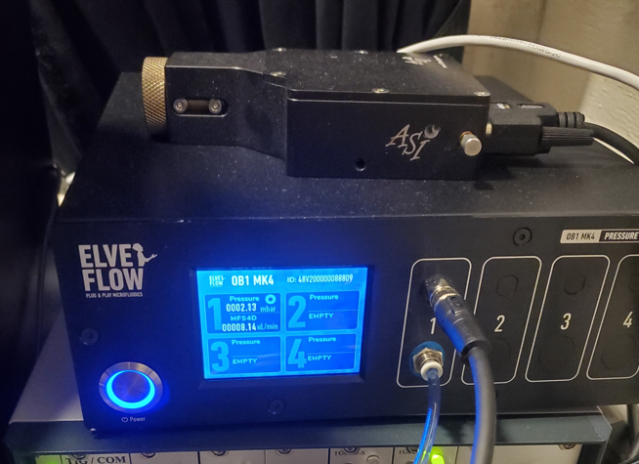
AutoCyPlex Updates
New Fluidic System
New imaging chamber
New illumination system
File System Organization
Auto Exposure Algorithm
Acquisition method update
Post acquisition pipeline
Auto Focus Algorithm
Air pressure fluidic system replaces peristaltic pinch valve system

Slide 8
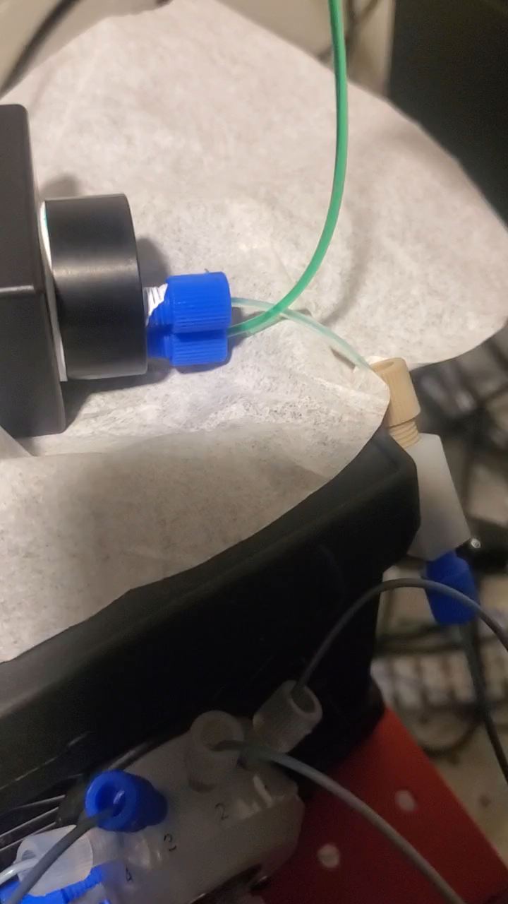
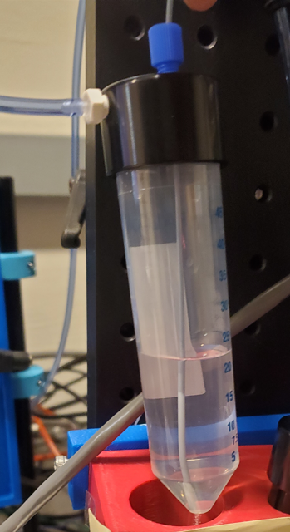

Slide 9
AutoCyPlex Updates
New Fluidic System
New imaging chamber
New illumination system
File System Organization
Auto Exposure Algorithm
Acquisition method update
Post acquisition pipeline
Auto Focus Algorithm

Slide 10
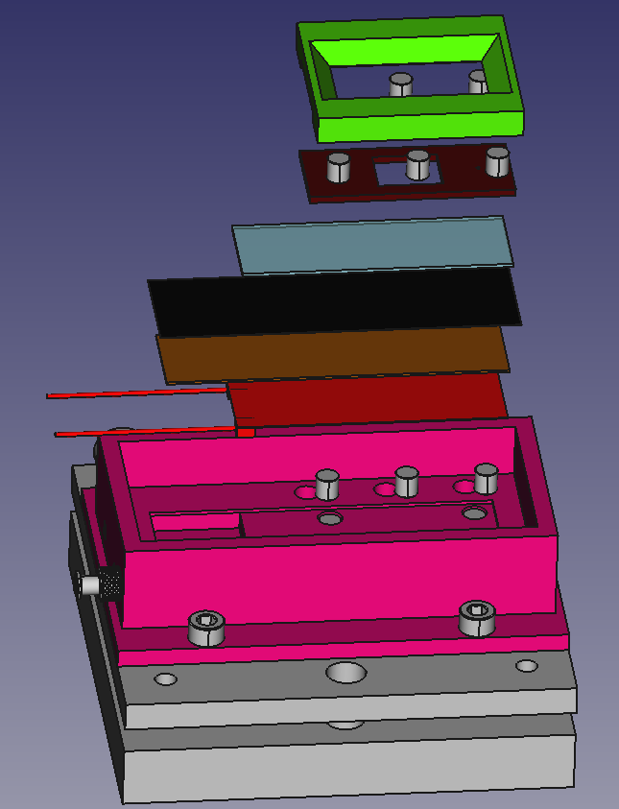
3D Printed Pressure Plate
Pressure Plate Embedded Magnets
Invisi-Slip MicroFluidic Device
Glass Slide
Maxi-Black Antireflective Material
Hard Setting Potting Compound
Positive Temperature Coefficient (PTC) Heating Element
Pressure Plate Chamber Mount Magnetics
Fluidic Device Stabilization Magnets
3D printed Chamber
M6 Mounting Machine Screws
Tilt Stage

Slide 11
Invisi-Slip microfluidic system (Claim 1)
Water Dipping Objective
Iron-Oxide Embedded Polydimethylsiloxane (PDMS)
3D Printed Pressure Plate
Water /Fluid
Fluorinated ethylene propylene (FEP) Film
Tubing
Tissue
Maxi-Black Anti-Reflective Material
Neodymium Magnets
Hard Set Potting Epoxy
Slide Glass
Positive Temperature Coefficient (PTC) heater
3D printed Chamber

Slide 12
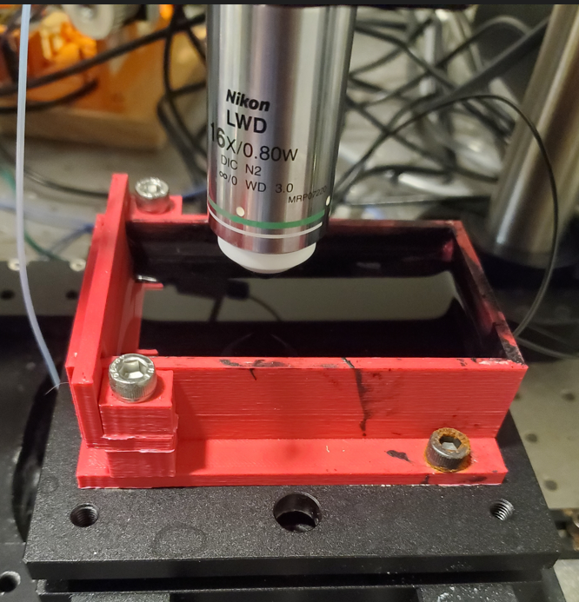
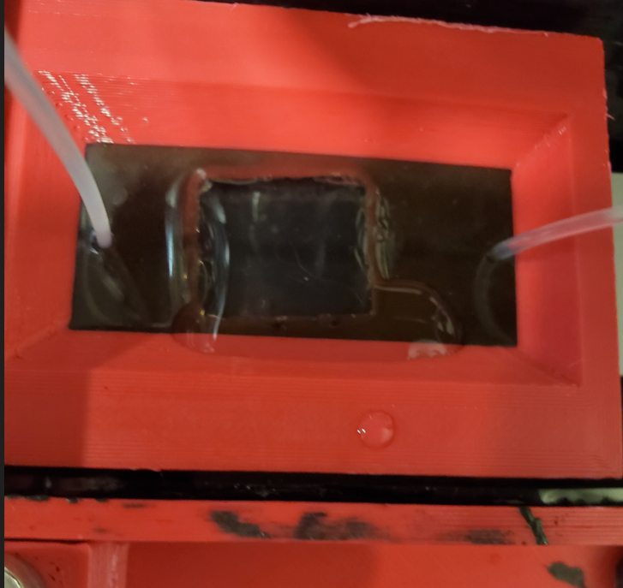
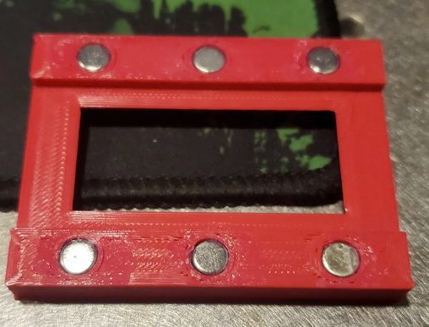

Slide 13
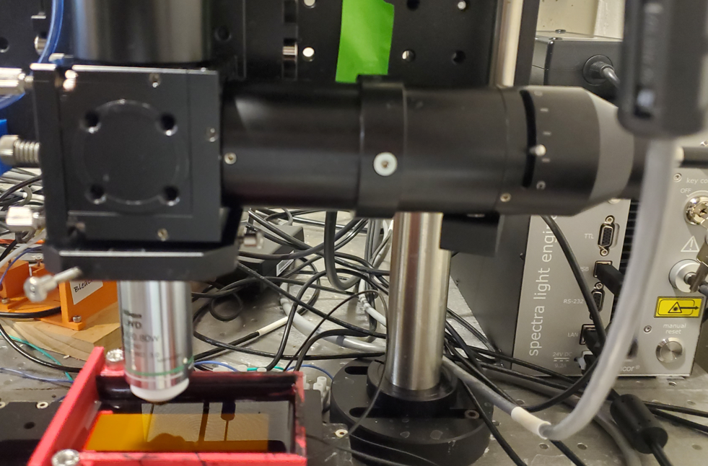
AutoCyPlex Updates
100 illumination tube
C60-camera spacer
LLG coupler
New Fluidic System
New imaging chamber
New illumination system
File System Organization
Auto Exposure Algorithm
Acquisition method update
Post acquisition pipeline
Auto Focus Algorithm

Slide 14
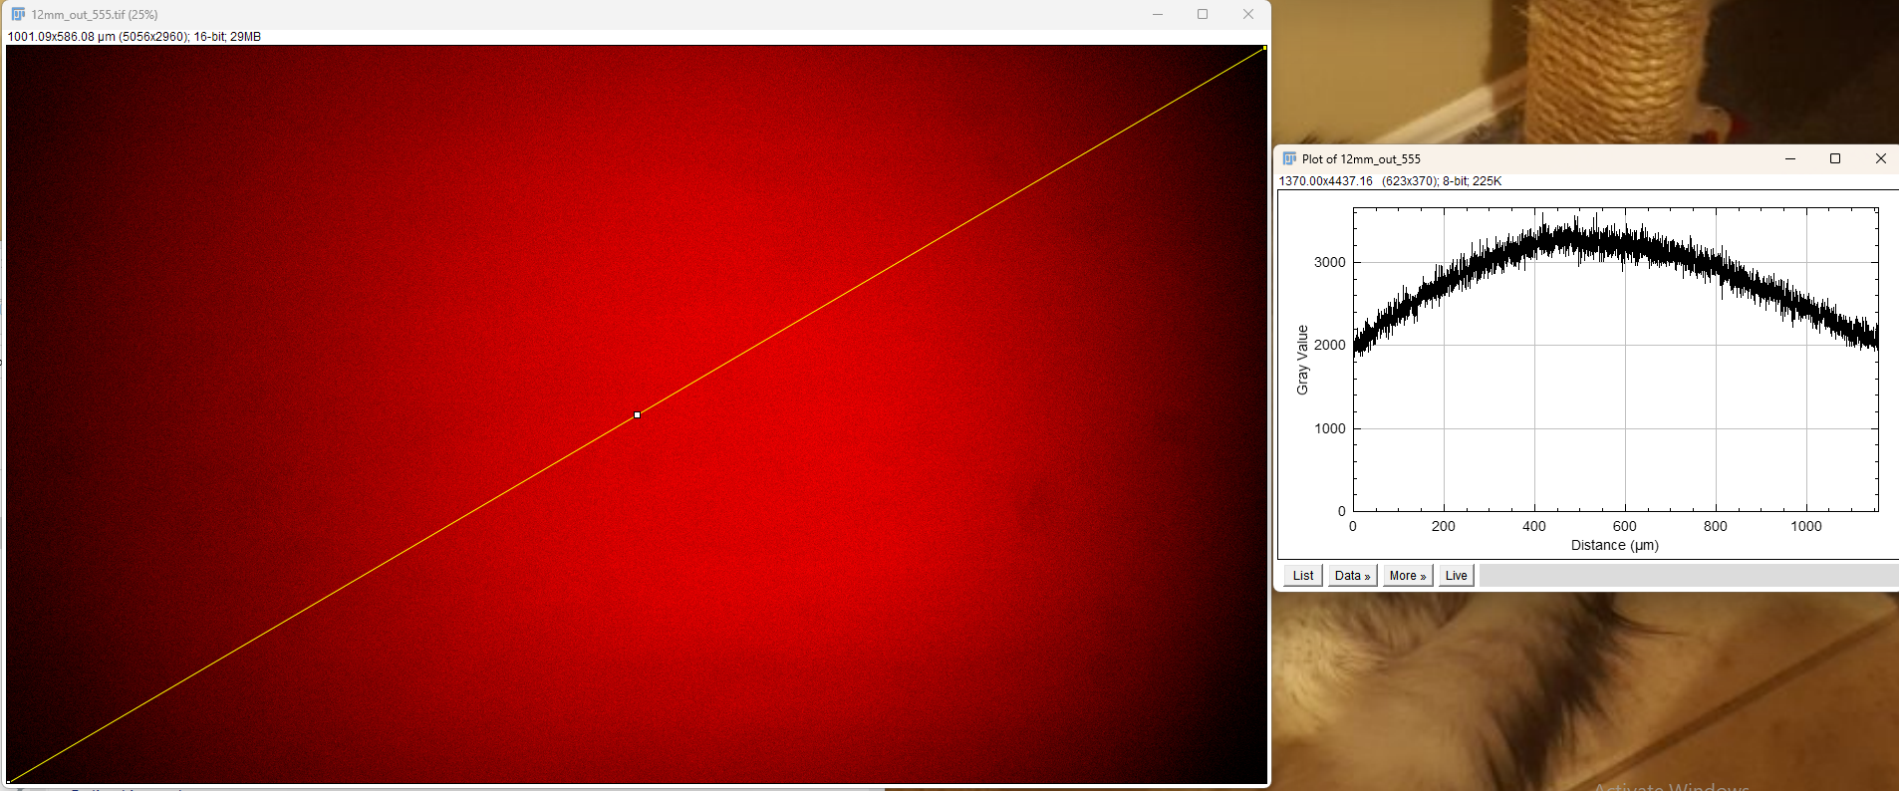
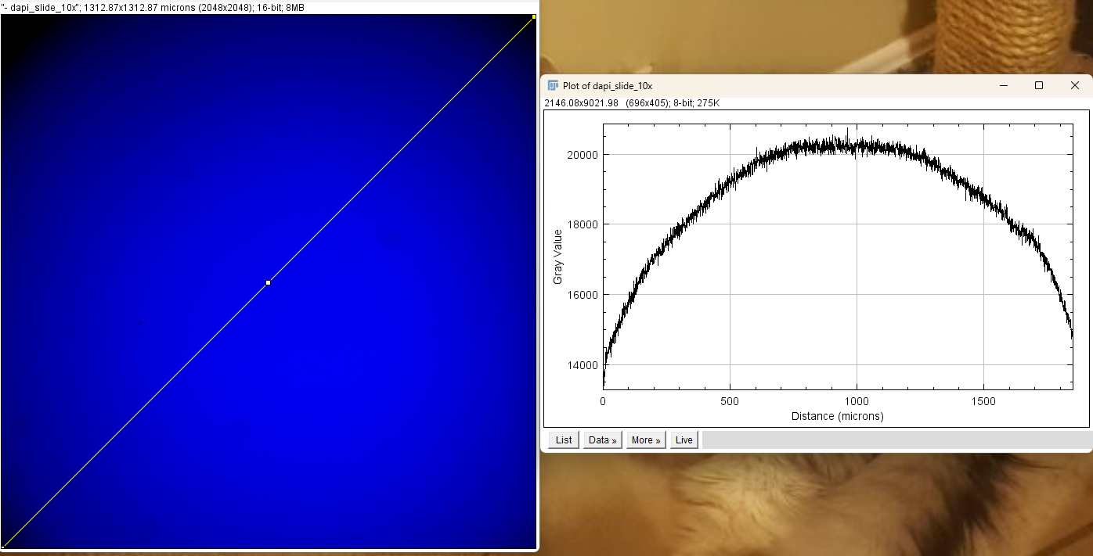
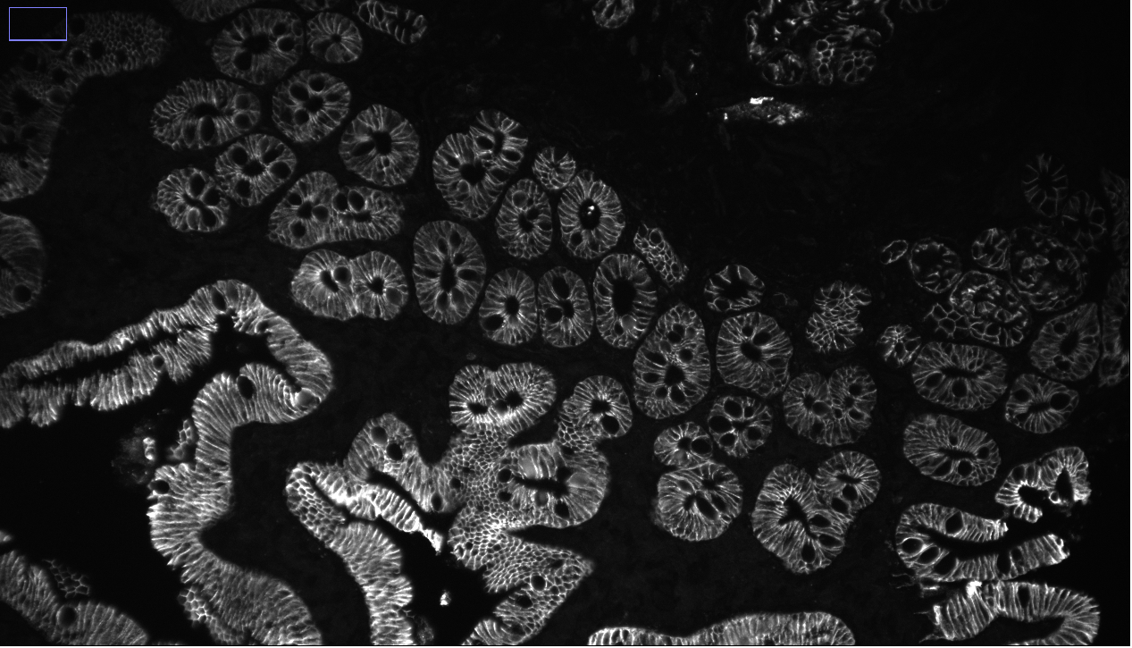
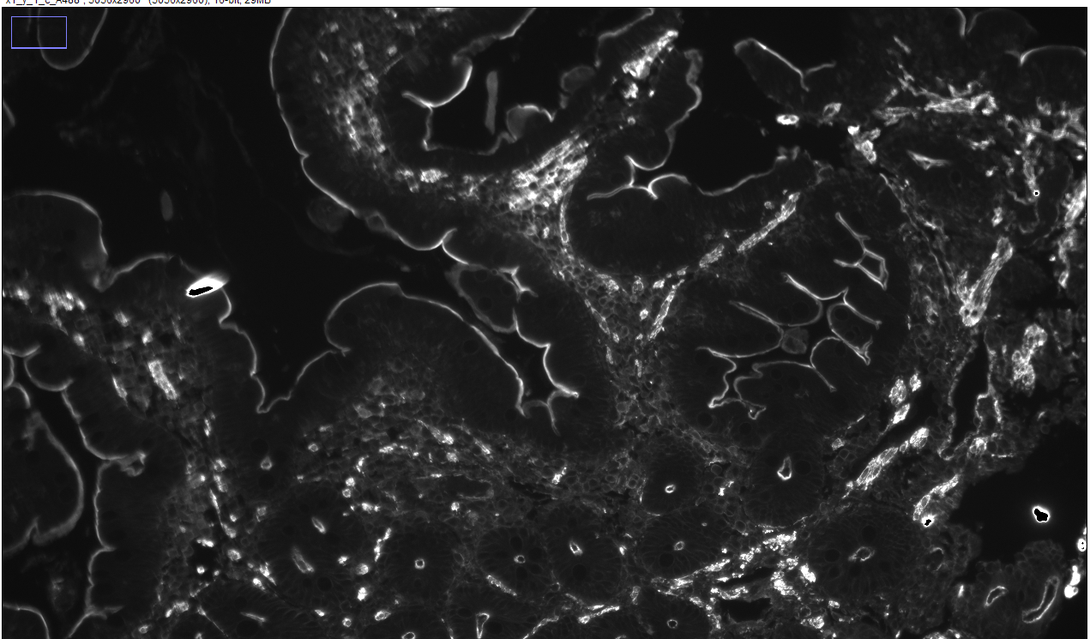
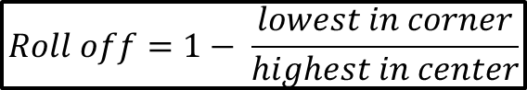
$$Roll off=1− \frac{lowest in corner}{highest in center}$$
New System (LLG) 41% roll off
Leica Thunder, 32% roll off
New Lumencor LLG Illumination System
Old ASI illumination system

Slide 15
AutoCyPlex Updates
Naming Structures
New Fluidic System
New imaging chamber
New illumination system
File System Organization
Auto Exposure Algorithm
Acquisition method update
Post acquisition pipeline
Auto Focus Algorithm
Quick Tiled images are named: placed_cy#_channel.tif
Tile images are named: z_#_x#_y_#_channel.tif
Focused tile images are named x#_y_#_channel.tif

Slide 16
Folder Hierarchy
Experiment Folder
Quick Tile
Contains all quick tiled images
DAPI
A488
A555
A647
Stain
cy_1
cy_2
Tiles
Each image is individually saved
Bleach
cy_3
Focused
In focus reconstructed tiles
Numpy
Numpy arrays for focus map and exposures
Mcmicro
Mcmicro input data
Channels
Stain or Bleach Images
Cycle number
Tiled images and individual images
Focused Tile Images

Slide 17
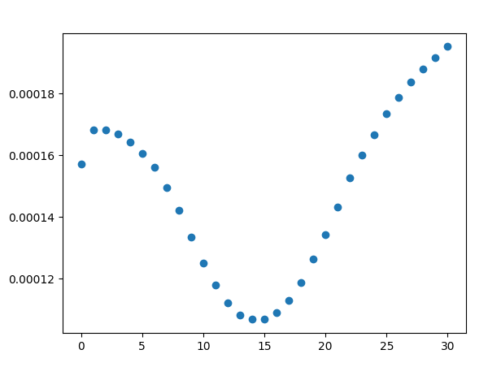
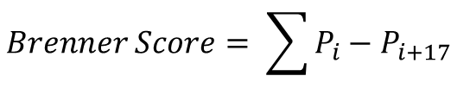
AutoCyPlex Updates
$$Brenner Score= \sum{P_{i}−P_{i+17}}$$
New Fluidic System
New imaging chamber
New illumination system
File System Organization
Auto Exposure Algorithm
Acquisition method update
Post acquisition pipeline
Auto Focus Algorithm
1/brenner score
Z plane number

Slide 18
High Level Block Diagram
XY Coordinates
Obtain XY tile coordinates via micro magellan surface
Choose Tiles
Determine which tiles to focus on
Capture 3 plane images
At each determined tile, capture full frame images from 3 different z planes
Gaps between z planes is predetermined
Break Images into super pixels
Calculate reciprocal Brenner Score
Filter Brenner Score
Divide each image into an array of sub areas dubbed ‘super pixels’
Calculate brenner score for each super pixel and take reciprocal of it
Brenner score is pixel(col, row) – pixel(col + n, row).
Filter out background super pixels via ‘Well Depth’
Make Focus Prediction
Take 3 point reciprocal brenner score, solve quad equation and solve for derivative = 0 to find projected focus position. Use Gauss-Jordan reduction to solve
Fit Plane
Fit best plane to all points (X,Y, Predicted focus z position)
Use outlier dampening loss function to best fit with
Populate Focus Map
Use Plane(XY coordinates) to determine Z position for focus map
Pop FM array with depth of focus across 1 FOV
Z value in FM is top value. Work down when capturing more planes

Slide 19
FM Array Constructions
Contains all channel info
Numpy array with dimensions (10, y_tiles, x_tiles). X and Y tile count come from Micro Magellan array
Dtype = int16
9
Number Z slices A647 with depth of focus step sizes
8
Top Z position A647
7
Number Z slices A555 with depth of focus step sizes
6
5
4
3
2
1
0
X positions
Y positions
Top Z position DAPI
Number Z slices DAPI with depth of focus step sizes
Number Z slices A488 with depth of focus step sizes
Top Z position A555
Top Z position A488

Slide 20
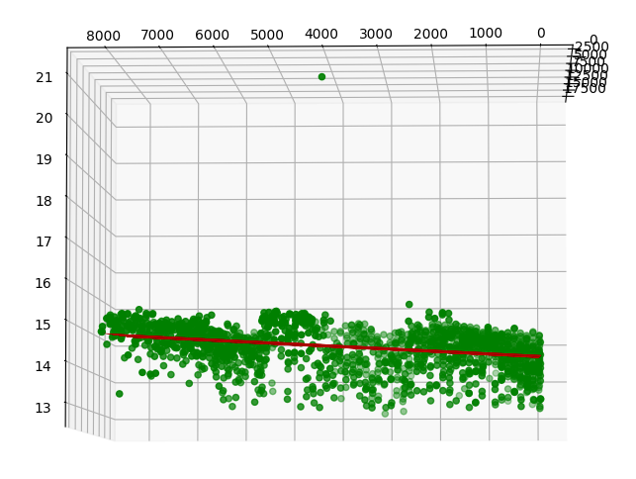
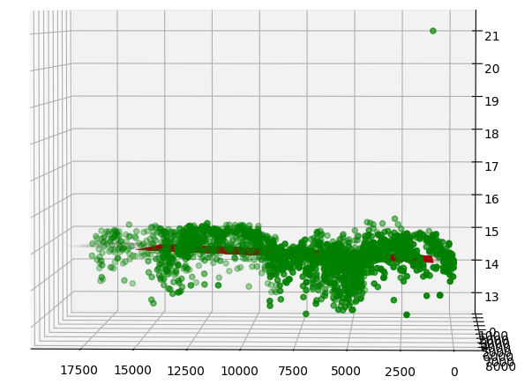
5.6 seconds for all processing with 12 tiles

Slide 21
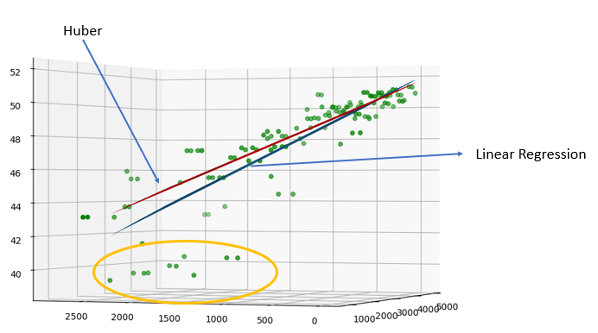
Loss Function

Slide 22
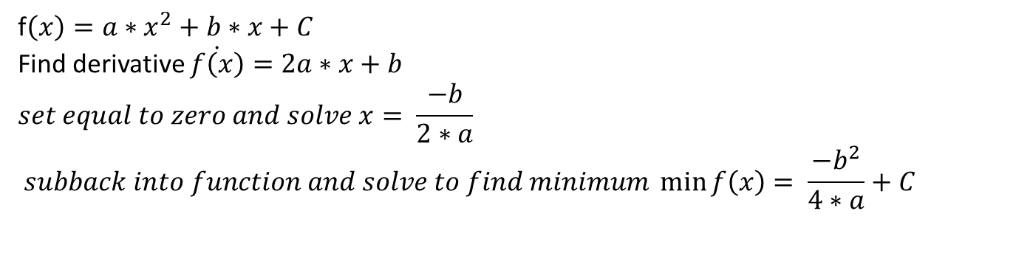
AutoCyPlex Updates
f$\left(x\right)=a∗x^{2}+b∗x+C$
Find derivative $\dot{f\left(x\right)}=2a∗x+b$
$$set equal to zero and solve x= \frac{−b}{2∗a}$$
$$subback into function and solve to find minimum \min_{}{f\left(x\right)= \frac{{−b}^{2}}{4∗a}+C}$$
New Fluidic System
New imaging chamber
New illumination system
File System Organization
Auto Exposure Algorithm
Acquisition method update
Post acquisition pipeline
Auto Focus Algorithm

Slide 23
Auto Exposure Algorithm
Start from 100ms exp time
Go to XY tile position
Take image with given channel
Check if image is within bounds at the 99% percentile pixel
If saturated
reduce exp time by 10x
retake image and recheck if still saturated.
Repeat 1-2 until not saturated anymore
Scale exp to give 10% dynamic range intensity
If too low
Scale exp to give 10% dynamic range intensity or 1000ms, which ever one that is lower exposure time
If not saturated add to exp_calc_array and move to next z point
Repeat steps 1-4 until all 3 z points are acquired w/ same exp time. Must retake images if needed
Repeat steps 1-5 until all 4 channels are set
Repeat for all XY position with starting exp time being rolled over from previous XY position
Solve quadratic equation for all three intensity points via gauss Jordan reduction method to solve for all coefficients.
Find intensity that is predicted via derivative of quad equation set to zero and subbed back in.
Cycle through all results as a function of XY position to find the highest predicted intensity after being scaled by exp time.
Take desired intensity/highest intensity to make a scale factor
Take acquired exp time and multiply by new scale factor.
If new exp time > 2000ms, make = 2000
If less than 2000ms, don’t alter new exp time

Slide 24
AutoCyPlex Updates
New Fluidic System
New imaging chamber
New illumination system
File System Organization
Auto Exposure Algorithm
Acquisition method update
Post acquisition pipeline
Auto Focus Algorithm
ZXY(snake)C
ZCXY(snake)

Slide 25
AutoCyPlex Updates
New Fluidic System
New imaging chamber
New illumination system
File System Organization
Auto Exposure Algorithm
Acquisition method update
Post acquisition pipeline
Auto Focus Algorithm

Slide 26
Processing Scheme
Python function name. mcmicro is linux program though
metadata_generator
metadata_generator
infocus
mcmicro_image_stack_generator
stage_placement
mcmicro
Function/program description
Create new metadata construct from known working xml set
Populate stage coords from saved experiment numpy array for the focus map. Update pixel size as well and frame size
Slice tile images into 10x10 sections and use brenner scores to determine in focus chunks. Use median filter on z plane chunk map to even out anomalies. Output reconstructed in focus tiles into focused folder
Populate mcmicro raw data with in focus tiles and add in metadata as a description
Create quick tile images into quick tile folder via stage coord placement with in focus tiles
Run mcmicro folder with mcmicro to flatten illumination via BaSiC and stitch and align cycles with Ashlar

Slide 27
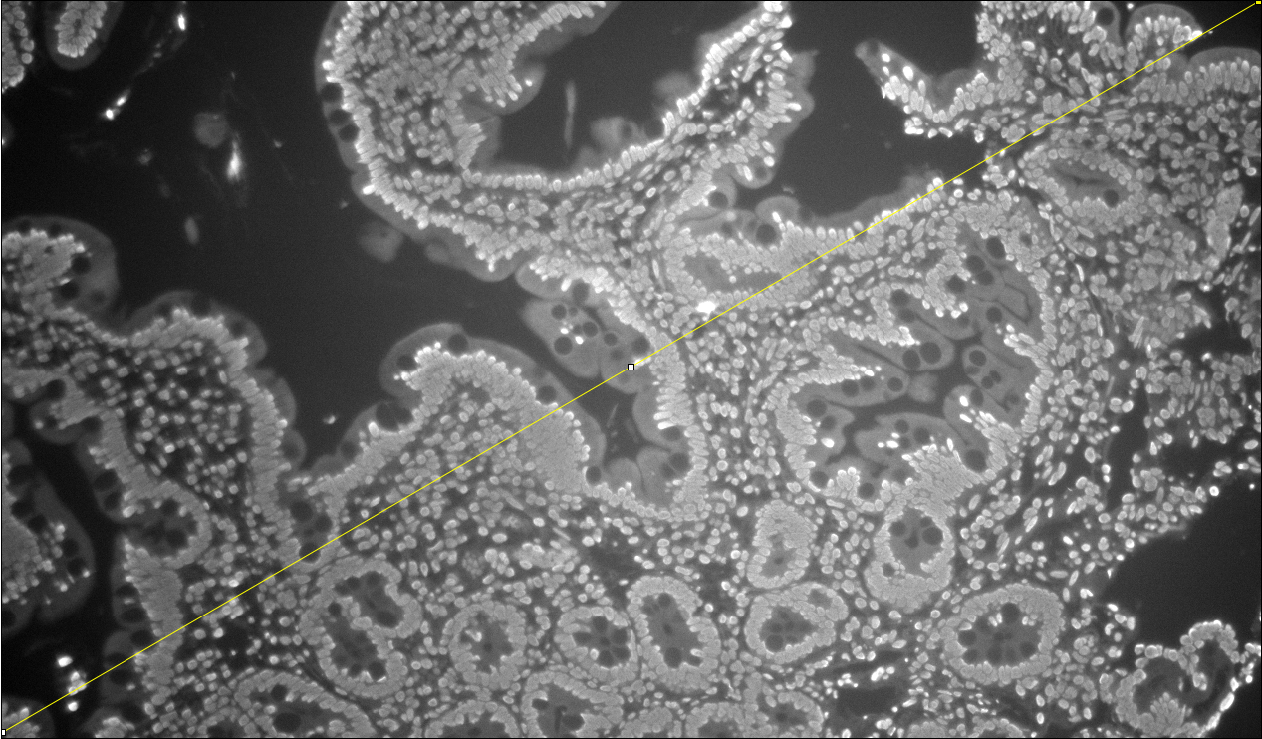
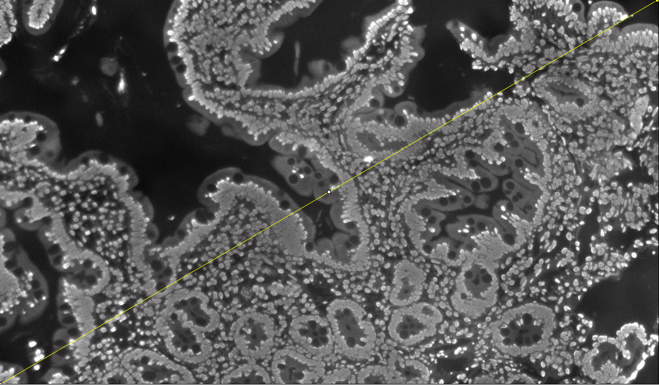
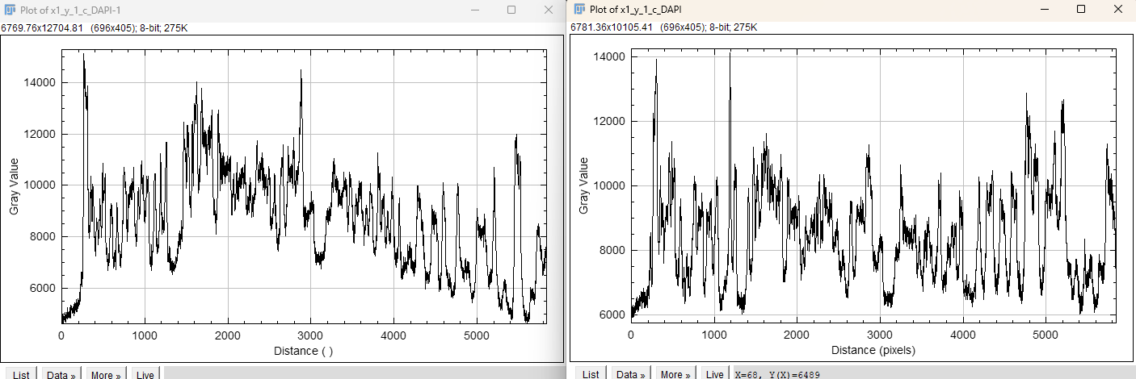
McMicro
= BaSiC image illumination flattening + Ashlar stitching
BaSiC Demo
Raw
Basic Estimator Applied
Ashlar
Stitches and aligns cycles for multiplex applications

Slide 28
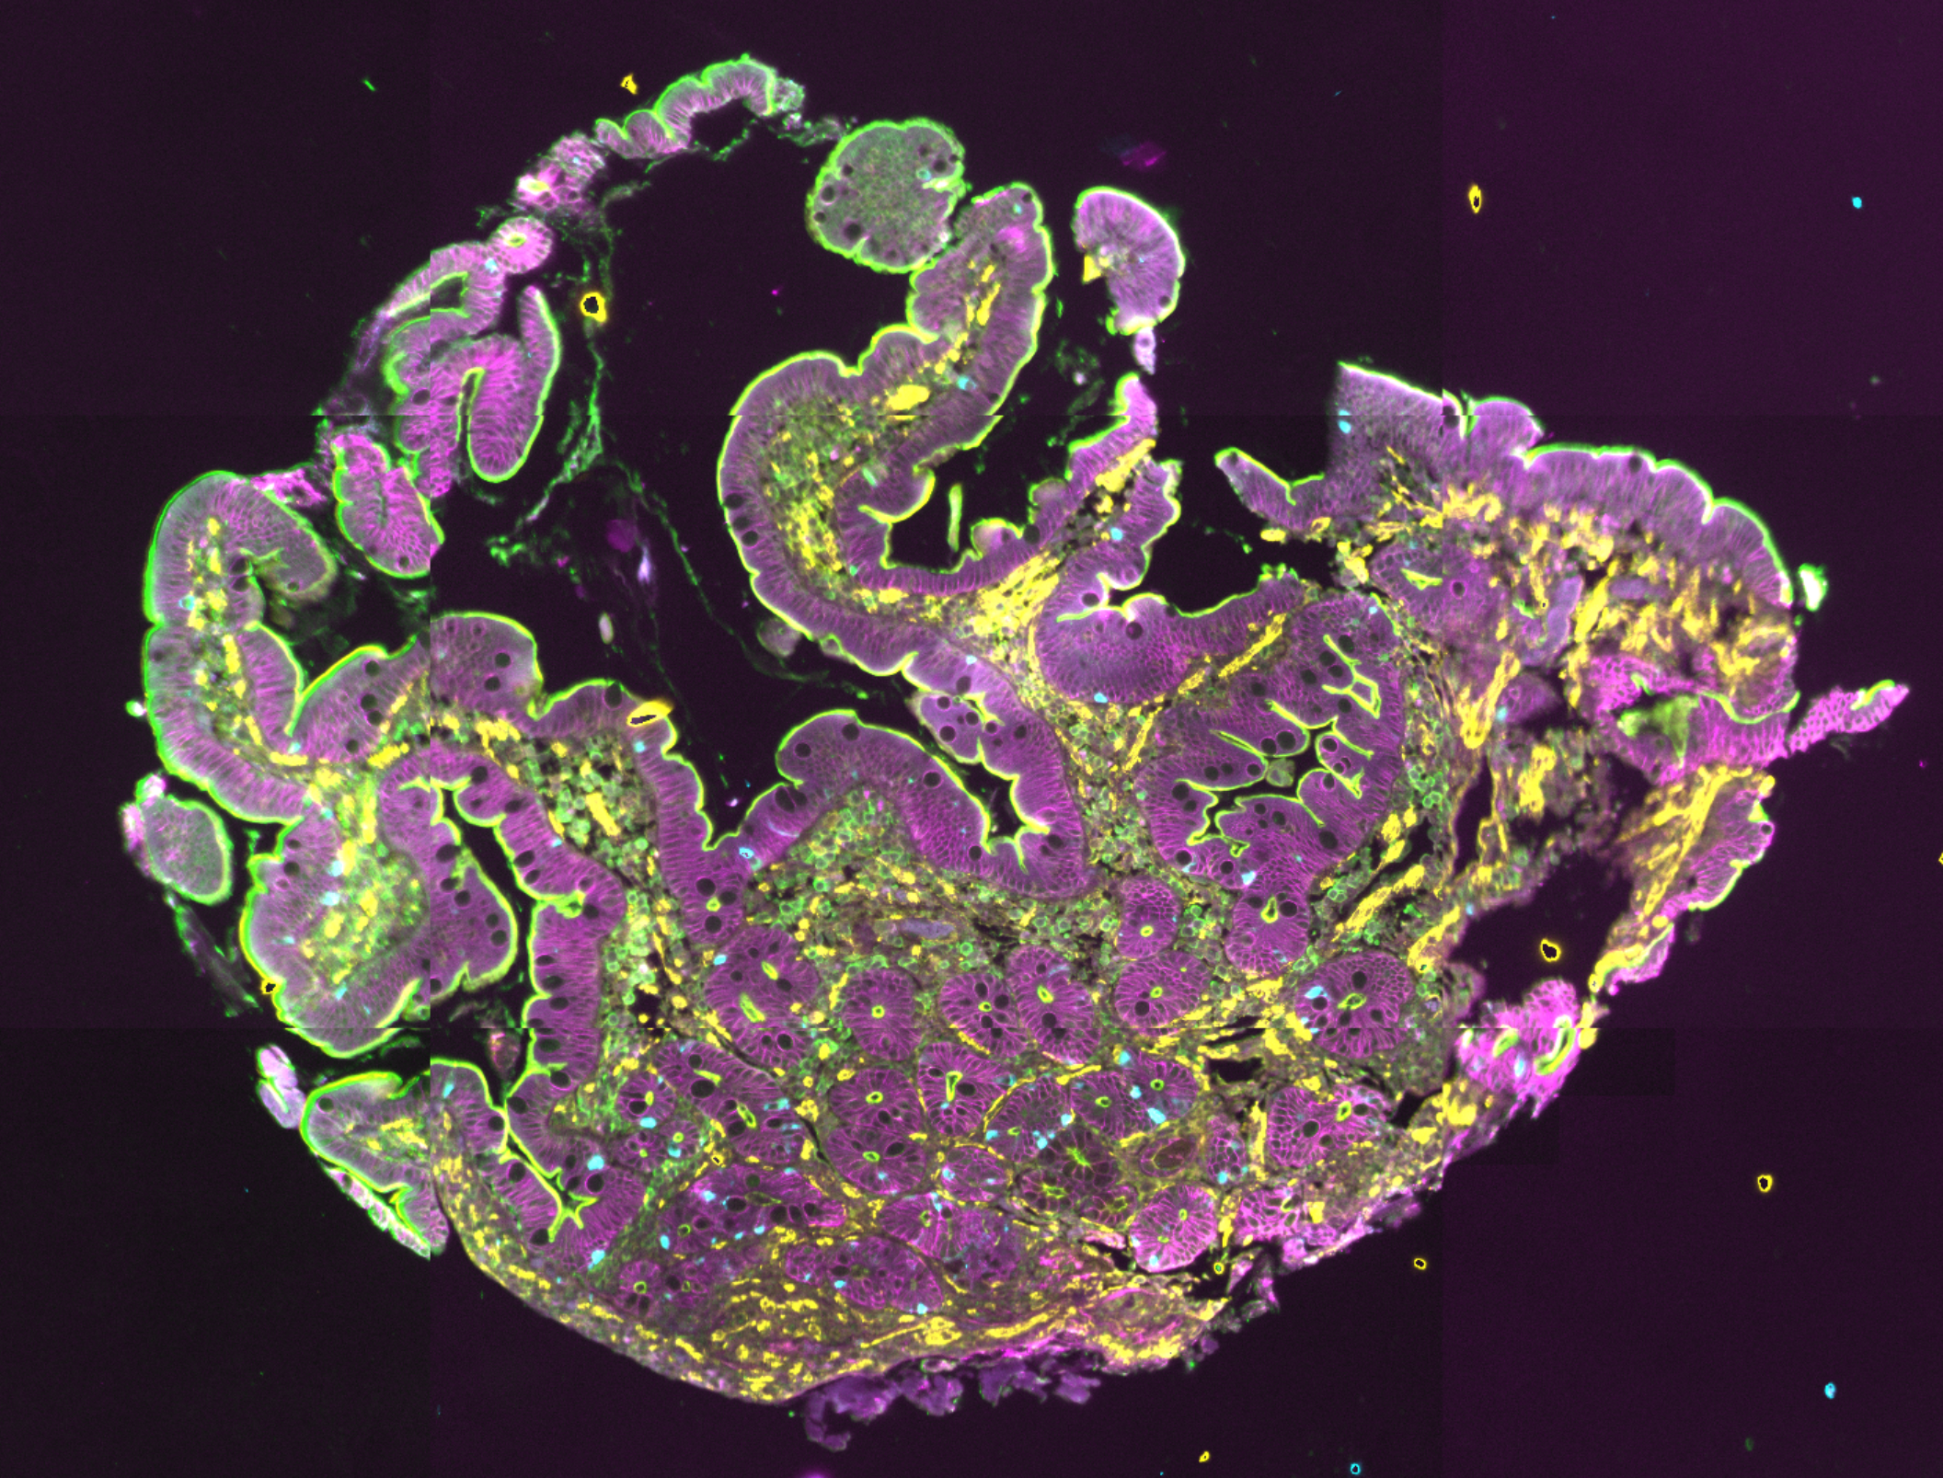
Test Run Results
Na ATPase
Ezrin
Smooth Muscle Actin
Chromogranin A

Slide 29
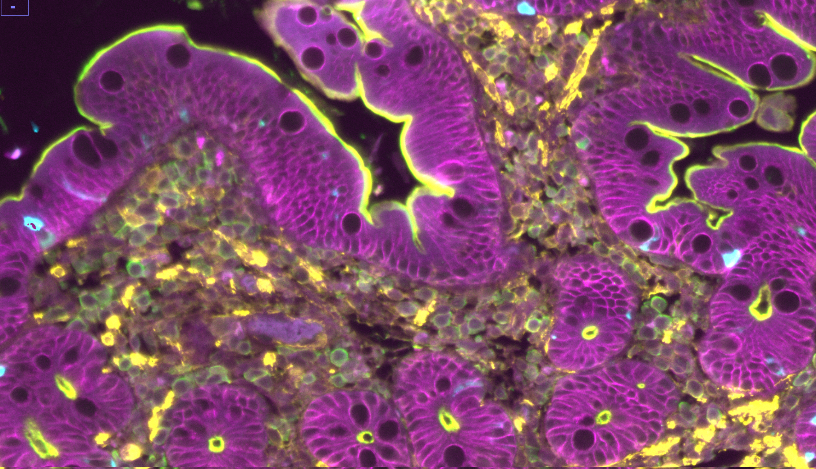
Na ATPase
Ezrin
Smooth Muscle Actin
Chromogranin A

